Slide 1
Chapter 2

Slide 2
Families of Organic Compounds
Organic compounds can be grouped into families by their common structural features
We shall survey the nature of the compounds in a tour of the families in this course
This chapter deals with alkanes, compounds that contain only carbons and hydrogens, all connected exclusively by single bonds

Slide 3
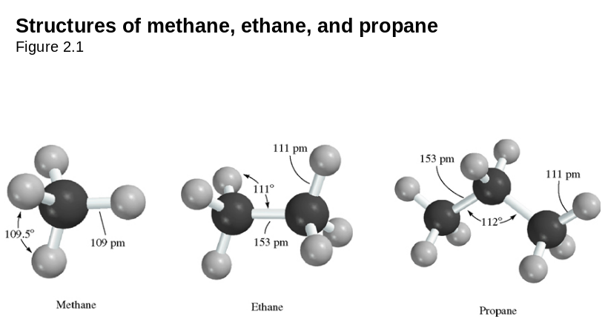

Slide 4
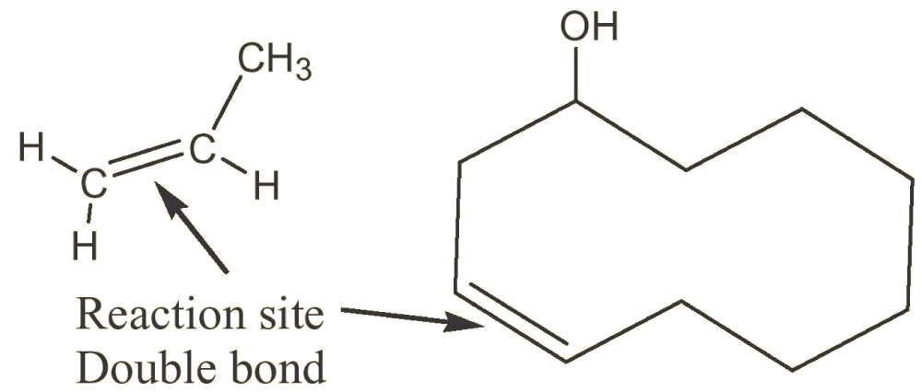
3.1 Functional Groups
Functional group - collection of atoms at a site within a molecule with a common bonding pattern
The group reacts in a typical way, generally independent of the rest of the molecule
For example, the double bonds in simple and complex alkenes react with bromine in the same way (See Figure 3.1)

Slide 5
Survey of Functional Groups
Table 3.1 lists a wide variety of functional groups that you should recognize
As you learn about them in each chapter it will be easier to recognize them
The functional groups affect the reactions, structure, and physical properties of every compound in which they occur

Slide 6
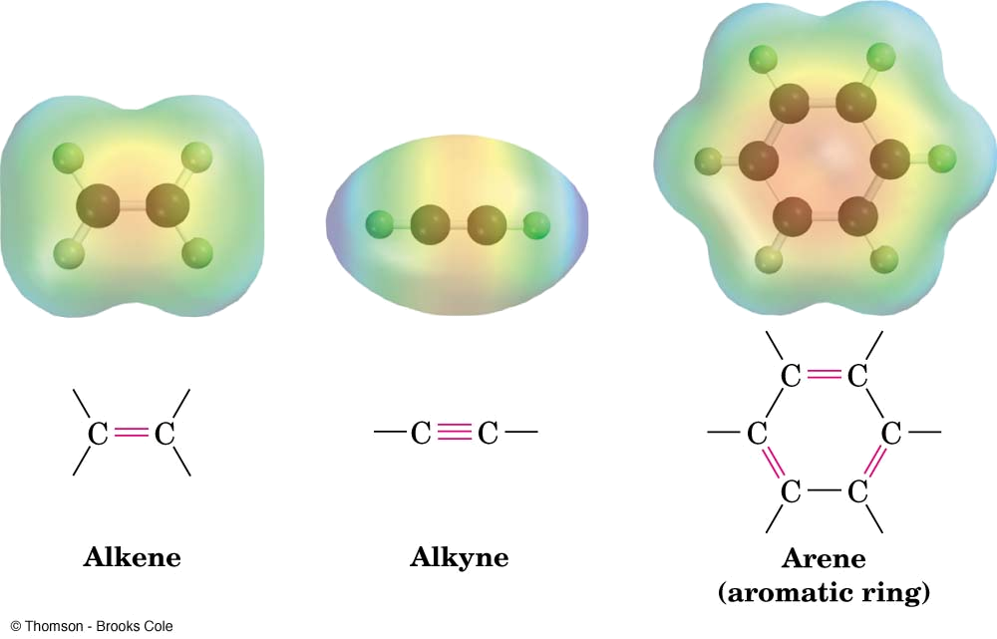
Types of Functional Groups: Multiple Carbon–Carbon Bonds
Alkenes have a C-C double bond
Alkynes have a C-C triple bond
Arenes have special bonds that are represented as alternating single and double C-C bonds in a six-membered ring

Slide 7
Functional Groups with Carbon Singly Bonded to an Electronegative Atom
Alkyl halide: C bonded to halogen (C-X)
Alcohol: C bonded O of a hydroxyl group (COH)
Ether: Two C’s bonded to the same O (COC)
Amine: C bonded to N (CN)
Thiol: C bonded to SH group (CSH)
Sulfide: Two C’s bonded to same S (CSC)
Bonds are polar, with partial positive charge on C (δ+) and partial negative charge (δ−) on electronegative atom

Slide 8
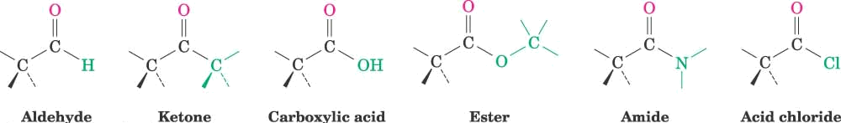
Groups with a Carbon–Oxygen Double Bond (Carbonyl Groups)
Aldehyde: one hydrogen bonded to C=O
Ketone: two C’s bonded to the C=O
Carboxylic acid: ⎯OH bonded to the C=O
Ester: C-O bonded to the C=O
Amide: C-N bonded to the C=O
Acid chloride: Cl bonded to the C=O
Carbonyl C has partial positive charge (δ+)
Carbonyl O has partial negative charge (δ-).

Slide 9
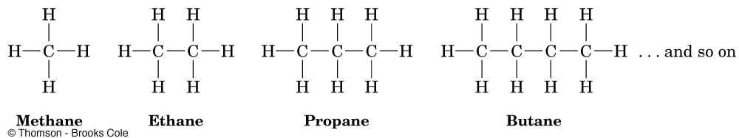
3.2 Alkanes and Alkane Isomers
Alkanes: Compounds with C-C single bonds and C-H bonds only (no functional groups)
Connecting carbons can lead to large or small molecules
The formula for an alkane with no rings in it must be C_{n}H_{2n+2} where the number of C’s is n
Alkanes are saturated with hydrogen (no more can be added
They are also called aliphatic compounds

Slide 10
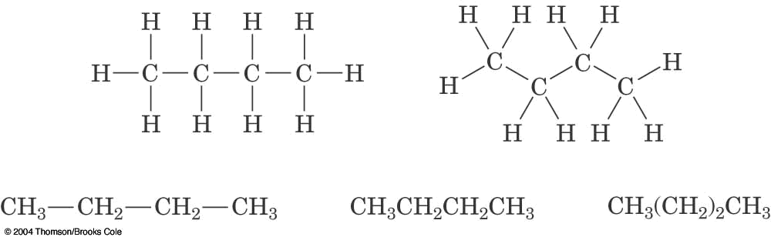
Different Ways to Write Butane

Slide 11


Alkane Isomers
CH₄ = methane, C₂H₆ = ethane, C₃H₈= propane
The molecular formula of an alkane with more than three carbons can give more than one structural isomer
  C₄H₁₀
  C₅H₁₂

Slide 12
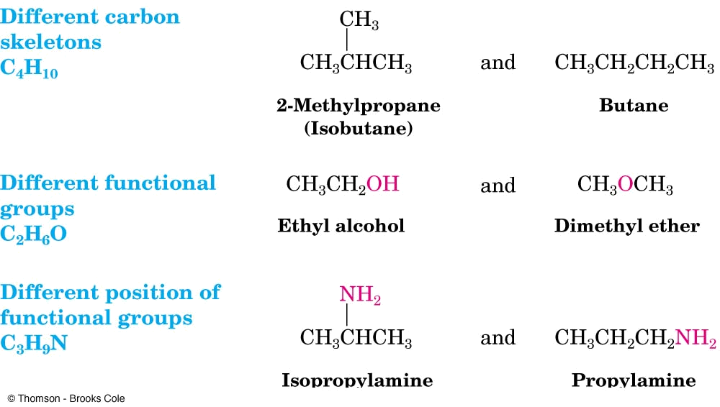
Constitutional Isomers
Isomers that differ in how their atoms are arranged in chains are called constitutional isomers
Compounds other than alkanes can be constitutional isomers of one another
They must have the same molecular formula to be isomers

Slide 13
Names of Small Hydrocarbons
No. of Carbons | Formula Name | (C_{n}H_{2n+2})
1 | Methane | CH₄
2 | Ethane | C₂H₆
3 | Propane | C₃H₈
4 | Butane | C₄H₁₀
5 | Pentane | C₅H₁₂
6 | Hexane | C₆H₁₄
7 | Heptane | C₇H₁₆
8 | Octane | C₈H₁₈
9 | Nonane | C₉H₂₀
10 | Decane | C₁₀H₂₂

Slide 14
Names of Larger Hydrocarbons
No. of Carbons | Formula Name | (C_{n}H_{2n+2})
11 | Undecane | C₁₂H₂₆
12 | Dodecane | C₁₂H₂₆
13 | Tridecane | C₁₃H₂₈
14 | Tetradecane | C₁₄H₃₀
15 | Pentadecane | C₁₅H₃₂
16 | Hexadecane | C₁₆H₃₄
17 | Heptadecane | C₁₇H₃₆
18 | Octadecane | C₁₈H₃₈
19 | Nonadecane | C₁₉H₄₀
20 | Isocane | C₂₀H₄₂

Slide 15
3.3 Alkyl Groups
Alkyl group – remove one H from an alkane (a part of a structure)
General abbreviation “R” (for Radical, an incomplete species or the “rest” of the molecule)
Name: replace -ane ending of alkane with -yl ending
  CH₃ is “methyl” (from methane)
  CH₂CH₃ is “ethyl” from ethane
See Table 3.4 for a list

Slide 16
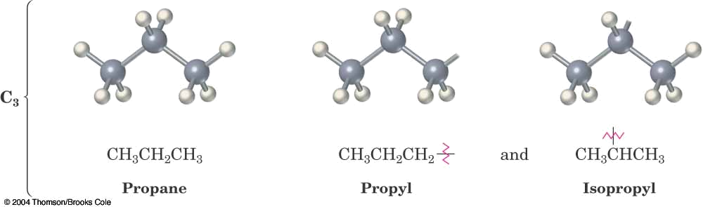

Slide 17
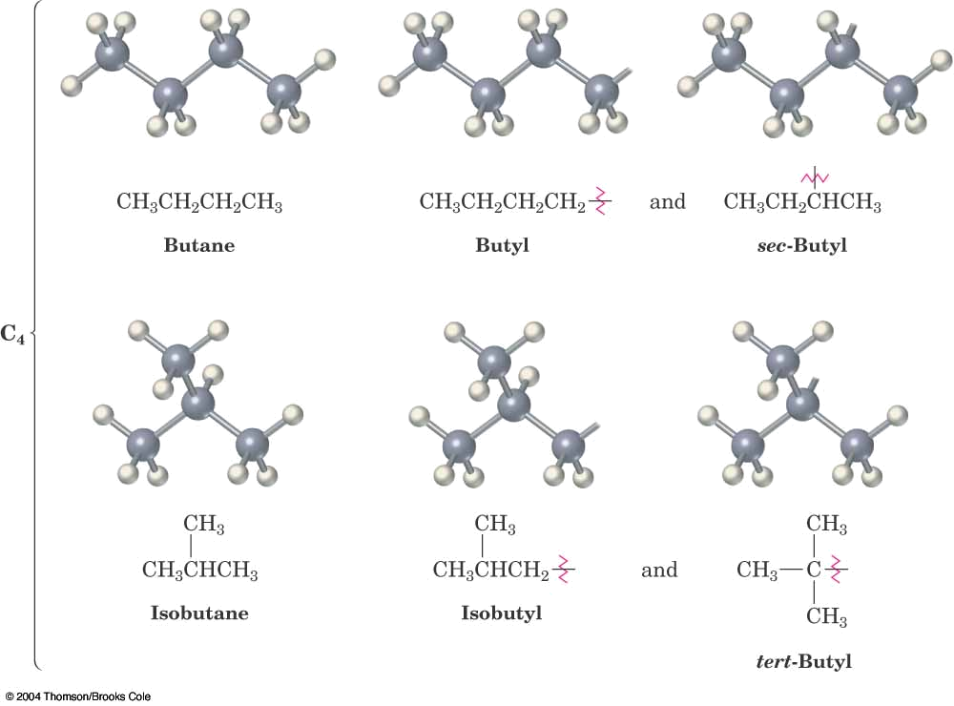

Slide 18
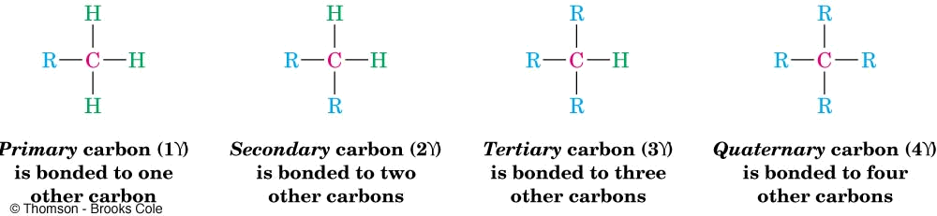
Types of Alkyl groups
Classified by the connection site (See Figure 3.3)
  a carbon at the end of a chain (primary alkyl group)
  a carbon in the middle of a chain (secondary alkyl group)
  a carbon with three carbons attached to it (tertiary alkyl group)

Slide 19
3.4 Naming Alkanes
Compounds are given systematic names by a process that uses
  Prefix-Parent-Suffix
Follows specific rules
  Named as longest possible chain
  Carbons in that chain are numbered in sequence
  substituents are numbered at their point of attachment
  Compound name is one word (German style)
  Complex substituents are named as compounds would be
See specific examples in text

Slide 20
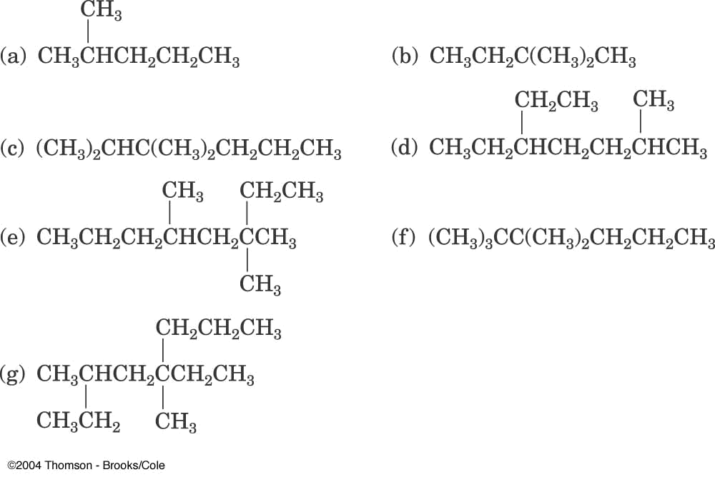

Slide 21
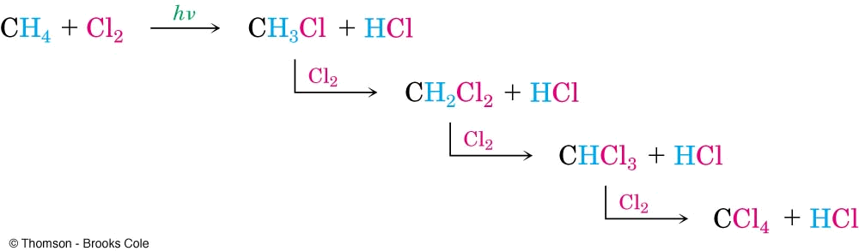
3.5 Properties of Alkanes
Called paraffins (low affinity compounds) because they do not react as most chemicals
They will burn in a flame, producing carbon dioxide, water, and heat
They react with Cl₂ in the presence of light to replace H’s with Cl’s (not controlled)

Slide 22
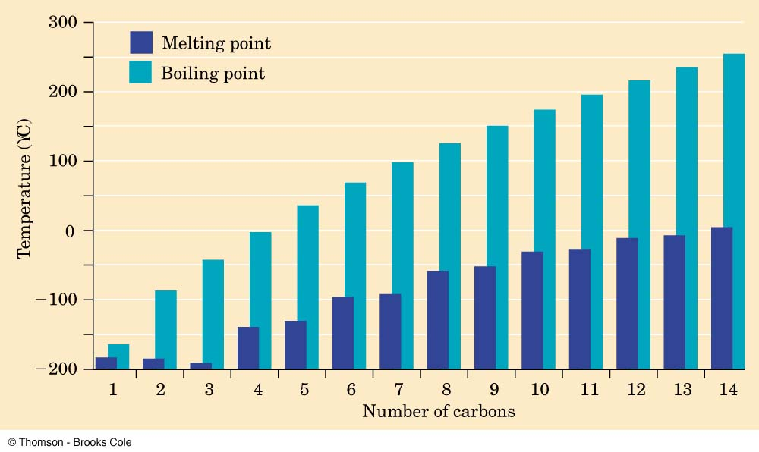
Physical Properties
Boiling points and melting points increase as size of alkane increases
Forces between molecules (temporary dipoles, dispersion) are weak

Slide 23
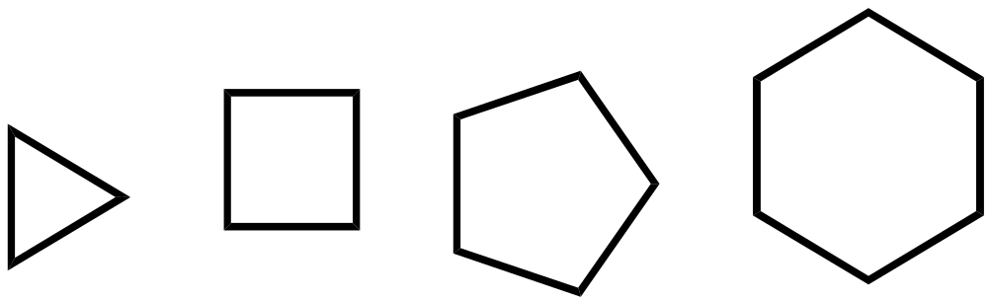
3.6 Cycloalkanes
Cycloalkanes are alkanes that have carbon atoms that form a ring (called alicyclic compounds)
Simple cycloalkanes rings of ⎯CH2⎯ units, (CH2)n, or CnH2n
Structure is shown as a regular polygon with the number of vertices equal to the number of C’s (a projection of the actual structure)
cyclobutane
cyclopentane
cyclohexane
cyclopropane

Slide 24
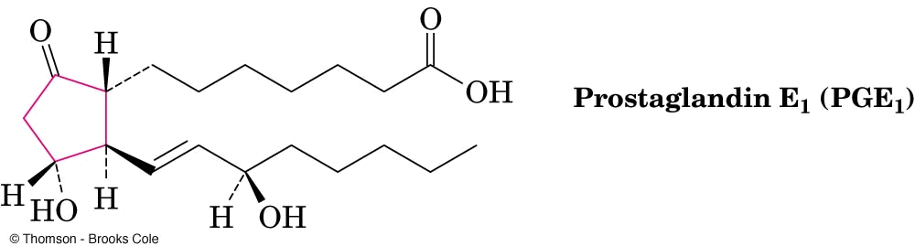
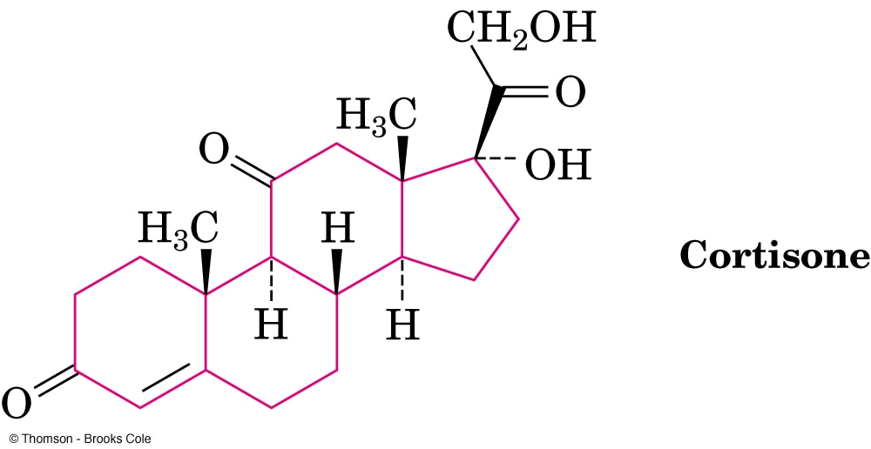
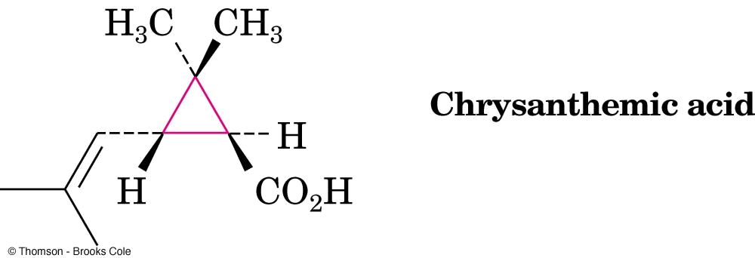
Complex Cycloalkanes
Naturally occurring materials contain cycloalkane structures
Examples: chrysanthemic acid (cyclopropane), prostaglandins (cyclopentane), steroids (cyclohexanes and cyclopentane)

Slide 25
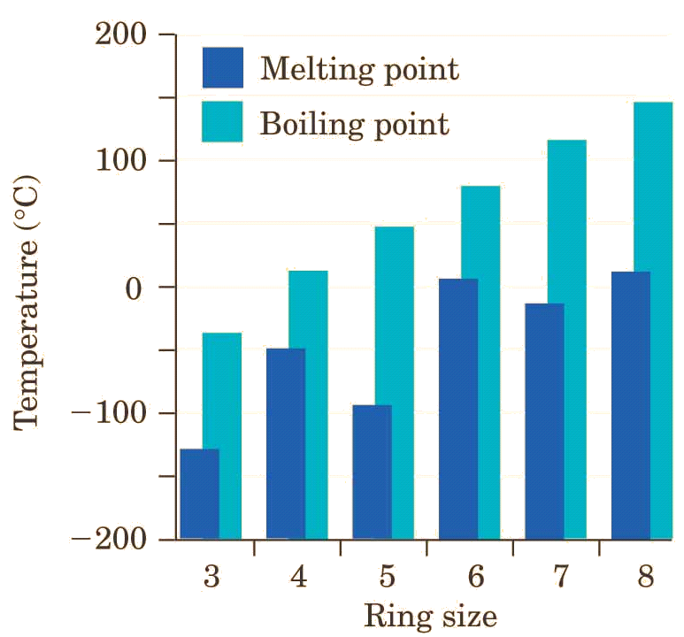
Properties of Cycloalkanes
Melting points are affected by the shapes and the way that crystals pack so they do not change uniformly

Slide 26
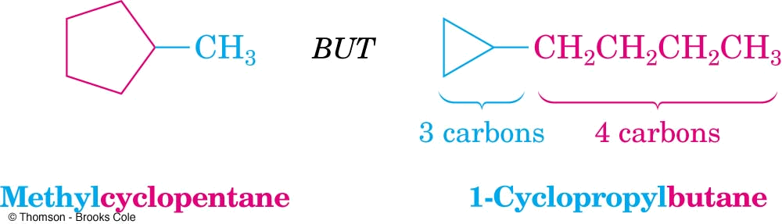
3.7 Naming Cycloalkanes
Count the number of carbon atoms in the ring and the number in the largest substituent chain. If the number of carbon atoms in the ring is equal to or greater than the number in the substituent, the compound is named as an alkyl-substituted cycloalkane
For an alkyl- or halo-substituted cycloalkane, start at a point of attachment as C1 and number the substituents on the ring so that the second substituent has as low a number as possible.
Number the substituents and write the name
See text for more details and examples

Slide 27
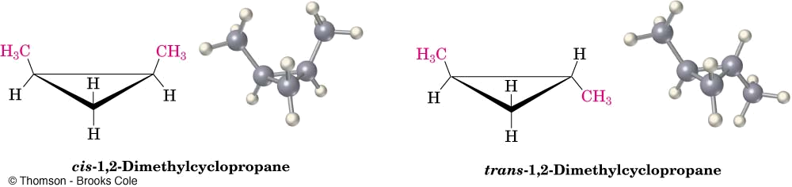
3.8 Cis-Trans Isomerism in Cycloalkanes
Rotation about C-C bonds in cycloalkanes is limited by the ring structure
Rings have two “faces” and substituents are labeled as to their relative facial positions
There are two different 1,2-dimethyl-cyclopropane isomers, one with the two methyls on the same side (cis) of the ring and one with the methyls on opposite sides (trans)

Slide 28
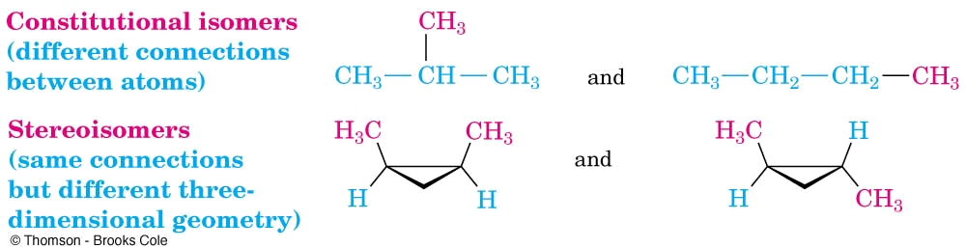
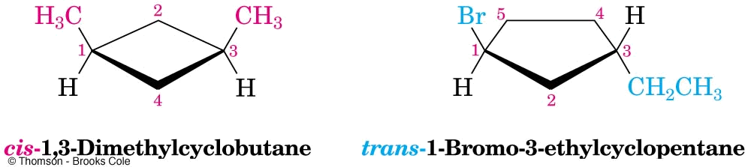
Stereoisomers
Compounds with atoms connected in the same order but which differ in three-dimensional orientation, are stereoisomers
The terms “cis” and “trans” should be used to specify stereoisomeric ring structures
Recall that constitutional isomers have atoms connected in different order

